Slide 1

HTML5, CSS3, and JavaScript
It’s about damn time.

Slide 2
HTML5
W3C
Founded in 1994 by Tim Berners-Lee
Ensures compatibility and agreement on standards among industry members
WHATWG
Founded by individuals of Apple, Mozilla, and Opera in 2004
Formed in response to W3C’s direction with XHTML and lack of interest in HTML

Slide 3
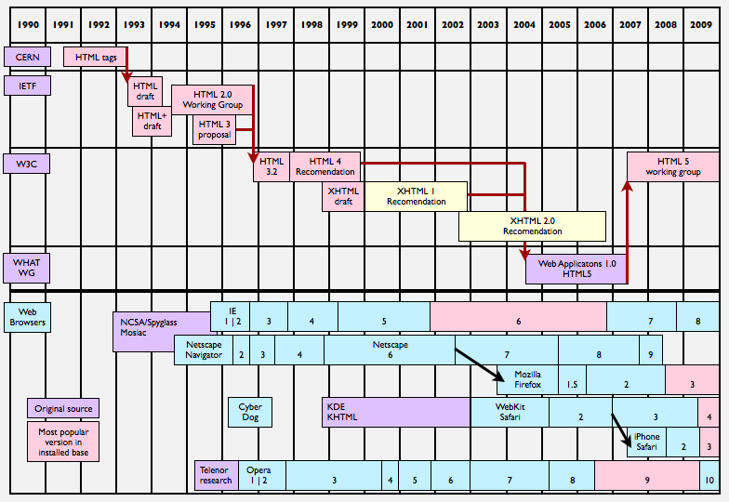
A Brief History of HTML5
http://www.appleinsider.com/print/09/09/19/why_apple_is_betting_on_html_5_a_web_history.html

Slide 4
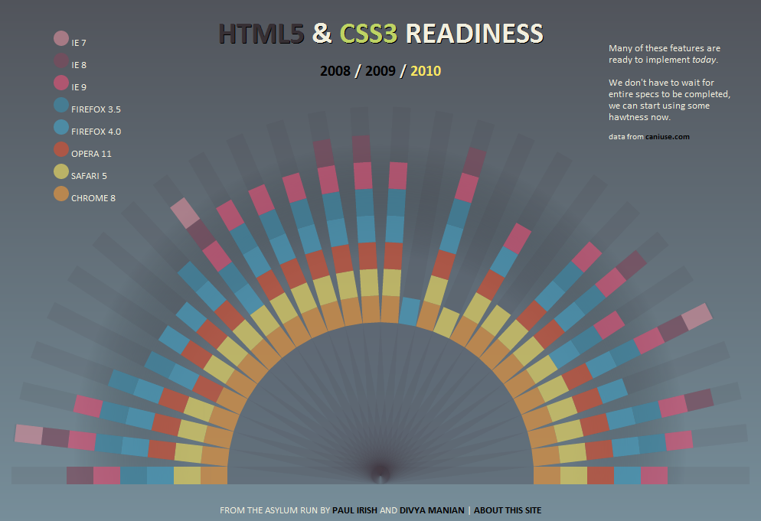
http://html5readiness.com/

Slide 5
Browser support
http://html5test.com/
http://html5readiness.com/
http://caniuse.com/

Slide 6
New HTML5 doctype
<!DOCTYPE html>
as opposed to:
<!DOCTYPE HTML PUBLIC "-//W3C//DTD HTML 4.01 Transitional//EN"
"http://www.w3.org/TR/html4/loose.dtd">
Backwards compatibility with all major browsers

Slide 7
New semantic tags for document structure
General layout
<header></header>
<footer></footer>
<section></section>
Specific layout
<article></article>
(blog post, article, comment, etc.)
<aside></aside>
(information that is tangential to the page, e.g., sidebars or pull-quotes)
<nav></nav>
(navigation)

Slide 8
In non-HTML5 browsers, these are rendered as block level elements, and may be styled as such
IE will only render these tags if they are programmatically generated by JavaScript
html5shiv does this for you (http://code.google.com/p/html5shiv/)
document.createElement("article")
or
<!--[if lt IE 9]>
<script src="http://html5shiv.googlecode.com/svn/trunk/html5.js">
</script>
<![endif]-->

Slide 9
Forms
New input types attribute values
Input types can provide clues for the browser to determine behavior; for example, in mobile browsers like mobile Safari, the input keyboard will change the spacebar to include special buttons like "@" for email address, or ".com" for urls
tel (telephone number)
email
url
search
range (numeric range selector)

Slide 10
Proposed input type attributes (with less browser support)
number
color
datetime
datetime-local
time
date
week
month
http://diveintohtml5.org/forms.html

Slide 11
New attributes for form elements
min/max/step
Sets a range for numeric values, with an optional "step" value for increment/decrement operations <number id="age" min="21" max="100" step="1" />
placeholder
Allows text to be included in an input field by default, but removes it when the user enters custom text
<input name="licensePlate" type="text" placeholder="e.g. ABC-123" />

Slide 12
autofocus
Provides a consistent way to automatically focus on a field when the page loads
<input name="firstField" type="text" autofocus />
If autofocus is not supported by a browser, it is easily implemented in JavaScript
if(!("autofocus" in document.createElement("input"))) { //test for attribute
document.getElementById("myElement").focus();
}

Slide 13
pattern
Allows a regular expression pattern to be defined for browser-based validation
list
The list attribute ties an input field to a specified range of values, defined by the <datalist> tag. <datalist id="sizes"> <option value="S" label="Small"> <option value="M" label="Medium"> <option value="L" label="Large"> </datalist> <input id="shirtSize" type="text" list="sizes" />

Slide 14
Media
Video
<video src="myVideo.ogg" controls></video>
Multiple source files may be specified for browsers that do not support one or more codecs
<video id="myVideo" controls>
<source src="myVideo.ogg" type="video/ogg">
<source src="myVideo.mp4">
Your browser does not support the video tag.
</video>
var video = document.getElementById("myVideo");
video.play();

Slide 15
Supported video codecs:
Ogg Theora
H.264
VP8 (WebM)
Others
http://en.wikipedia.org/wiki/HTML5_video#Table

Slide 16
Audio
<audio id="myAudio" src="myAudio.mp3" controls></audio>
Supported audio codecs:
Ogg Vorbis
WAV PCM
MP3
AAC
Speex
http://en.wikipedia.org/wiki/HTML5_audio#Audio_format_support

Slide 17
Progress
<progress id="myProgress" value="0" max="100" />
var progress = document.getElementById("myProgress");
for(var i = 0; i <= 100; i++) {
progress.value = i;
}

Slide 18
Drawing
SVG (Scalable Vector Graphics)
SMIL (Synchronized Multimedia Integration Language), aka SVG+time
HTML-like tags for drawing
SVG better with large static content
SVG forms a "tree" of objects, so it is easier to perform hit-detection or add event handlers to elements in the tree
Better for user interfaces than canvas
<svg width="200" height="200">
<rect id="myRect" class="graph" x="0" y="0" width="100" height="100" fill="blue" stroke="red" stroke-width="5px" rx="8" ry="8" />
</svg>
var rect = document.getElementById("myRect");
rect.style.fill = "green";
rect.onclick = function() { alert("myRect clicked"); }

Slide 19
Canvas
<canvas></canvas>
Scriptable rendering of shapes and bitmaps (scriptable image tag)
Mouse interaction through event listeners
Demanding animation
JavaScript centric
Pixels (bitmap)
Better for animations and games
Canvas is lower level and generally faster

Slide 20
<canvas id="myCanvas" width="150" height="150"></canvas>
var canvas = document.getElementById("myCanvas");
var context = canvas.getContext("2d");
context.fillStyle = "rgb(200, 0, 0)"; //red
context.fillRect(10, 10, 55, 50);
context.fillStyle = "rgba(0, 0, 200, 0.5)"; //opacity
context.fillRect(30, 30, 55, 50);

Slide 21
Data Attributes
<div data-price="12.95">...</div>
<div data-name="TRON action figure">...</div>
Any attribute that begins with data- is treated as valid
Allows developers to add custom attributes to elements without violating HTML validation
No need to use rel or rev attributes
The HTML5 specification defines a .dataset property to be added to elements to access data- attributes (key/value pairs), but this has not been implemented in any browser so the .getAttribute() function must be used instead

Slide 22
<div id="address">
<span data-address="street">123 Nowhere</span><br />
<span data-address="city">Nowheresville</span>,&nbsp;
<span data-address="state">MO</span><br />
<span data-address="zip">55555</span>
</div>
<button id="getData">Get Data</button>
$(document).ready(function() {
$("#getData").click(function() {
var addressParts = $("#address span");
$.each(addressParts, function(index) {
var data = addressParts[index].getAttribute("data-address");
alert(data);
});
});
});

Slide 23
HTML5 Problems
Disagreement among vendors re: features
Spotty support in some browsers, but decent support in mobile browsers
Code defensively -- test for features before using them
Use Modernizr to provide fallback implementations for browsers that don't support HTML5/CSS3 features (http://www.modernizr.com/)
Gracefully degrade when browsers don't support HTML5 features ("progressive enhancement")

Slide 24
CSS3
Under development since December, 2005
Divided into “modules”, the progress of which are reported by the W3C at http://www.w3.org/Style/CSS/current-work#table

Slide 25
@font-face
Specify your own downloadable fonts
@font-face {
font-family: Delicious;
src: url('Delicious-Roman.otf');
}
h3 { font-family: Delicious, sans-serif; }
OTF = open type fonts
TTF = true type fonts

Slide 26
Open fonts available via the Google font API: http://code.google.com/webfonts
Commercial fonts available via Typekit: http://typekit.com/

Slide 27
Selectors
Support for CSS3 selectors is supported by most browsers, but only semi-supported in IE (rumored to be supported in IE9)
http://www.css3.info/selectors-test/

Slide 28
Attribute Selectors
Selector | Effect
E[type="text"] | Select all input elements with a type attribute set to "text"
E[class^="nav"] | Select all anchor elements with a class name that begins with "nav"
E[class$="sidebar"] | Select all div elements with a class name that ends with "sidebar"
E[lang*="en"] | Select all paragraph elements with a language attribute that contains "en"

Slide 29
Pseudo Selectors
Selector | Effect
E:first-child | Selects the first child element of type E
E:last-child | Selects the last child element of type E
E:nth-child(2) | Selects the nth child element of type E
E:disabled | Selects the elements of type E that are disabled (input)
E:checked | Selects the elements of type E that are checked (input)
E:not([class="even"]) | Selects all elements of type E that do not have a class “even”

Slide 30
Borders
border-radius
-moz-border-radius: [px|em]
-moz-border-radius-topleft: [px|em]
-webkit-border-radius: [px|em]
-webkit-border-top-left-radius: [px|em]

Slide 31
border-image
-moz-border-image: url('xyz.png') 27 27 27 27 round round
-webkit-border-image: url('xyz.png') 27 27 27 27 stretch stretch
Widths represent the top, right, bottom, and left pixel widths of the border
"round round" repeats the image pattern across the whole element
"stretch stretch" stretches the width and height of the image across the whole element

Slide 32
box-shadow
-moz-box-shadow: 0px 3px 200px [#000000 | rgba(0, 0, 0, 0.9)]
-webkit-box-shadow: 0px 3px 200px [#000000 | rgba(0, 0, 0, 0.9)]
First argument is the x-offset for the box shadow; a positive value puts it to the right, a negative value puts it to the left
Second argument is the y-offset for the box shadow; a positive value puts it to the bottom, a negative value puts it to the top
Third argument is the blur radius; higher the value, the wider the blur
The last value is the color, and may be hex or rgba(), which allows for opacity specification
Optional "inset" argument creates an "inner" drop shadow

Slide 33
Multiple Backgrounds
background: url('first-image.png') 0px 0px, url('second-image.png') 140px 140px;
The first background is the foreground image, subsequent images will be stacked accordingly
Using individual background- properties, the order of arguments matter
background-position: 0px 0px, 140px 140px;
background-repeat: no-repeat, repeat;
Background images may also be resized (width, height) in pixels or percentages:
background-size: 256px 256px;
Backgrounds can scale automatically using "cover" or "contain"
background-size: cover;
//image is scaled until it fits the largest dimension of the containing element
background-size: contain;
//image is scaled until it fits the smallest dimension of the containing element

Slide 34
Gradients
Support for three gradient types:
Linear
Radial
Image + gradient

Slide 35
Mozilla linear
background-image: -moz-linear-gradient(top, #ff0000, #0000ff);
First argument is where the gradient starts -- can also be px, deg, and rad
Next two arguments are the starting and ending colors, respectively
Additional colors may be added between start and ending colors; by default they will be evenly distributed
Colors maybe be "moved" by using stop point positions (%, px, or em): #0000ff 0%, #fffff 60%, #00ff00 100%

Slide 36
Webkit linear
background-image: -webkit-gradient(linear, left top, left bottom, from(#ff0000), to(#0000ff));
Type of gradient specified as first argument
Next two argument specifies where the start and endpoints are for the gradient, and may be integer values
Last two arguments are functions defining starting and ending colors, respectively
Additional colors may be added between the start and ending colors; by default they will be evenly distributed
Colors may be "moved" by using the color-stop function: color-stop(0%, #0000ff), color-stop(60%, #ffffff), color-stop(100%, #00ff00)

Slide 37
Mozilla radial
background-image: -moz-radial-gradient(center, circle, #ff0099 0%, #e4c700 100%);
Use "ellipse" instead of "circle" for an elliptical gradient
Webkit radial
background-image: -webkit-gradient(radial, center center, 0, center center, 625, from(#ff0099), to(#e4c700));
Gradient is formed by two concentric circles and drawing a gradient between them
"center center" is the coordinates of the circle; may be integer values

Slide 38
Mozilla image + gradient
background-image: url('my-image.png'), -moz-radial-gradient(center, circle, #ff9900 0%, #000 100%);
Opacity of the image should be set low to blend the image and gradient
No WebKit support (?)

Slide 39
JavaScript APIs
New JavaScript APIs in HTML5:
Drag-and-drop events
Data storage
Geolocation
Web workers
Websockets (not technically part of HTML5)

Slide 40
Drag-and-Drop Events
dragstart
drag
dragenter
dragover
dragleave
drop
dragend

Slide 41
Data Store
There are three new data store APIs available for developers
App cache
Web storage
Web SQL DB

Slide 42
App cache
Create a special .manifest file with CACHE MANIFEST as the first line, and then list all resources you want to take offline
Add the manifest attribute to the body tag of the web page
The .manifest file must have a unique MIME type, set by the application server
Caching happens per-page, and caching space is limited
CACHE MANIFEST
/assets/images/myImage.png
/assets/scripts/myScript.js
/asset/styles/myStyles.css
/static/myPage.html
<body manifest="/cache.manifest"></body>

Slide 43
Web storage API
Web storage information is not sent with requests to the server, like cookies are
Simple key/value database with a global namespace
Non-string keys and values may be used, but they will be converted to strings via the Object.toString() function
localStorage |  | sessionStorage
Persistent even when window is closed; only cleared when user or software clears it out manually Accessed with localStorage global object |  | Transitory; clears when window is closed Accessed with sessionStorage global object

Slide 44
Storage members:
[storage].setItem("key", "value");
[storage].getItem("key");
[storage].removeItem("key")
[storage].clear()
[storage].length
[storage].key(n) //returns nth key
Most implementations also allow additional JavaScript hash syntax:
[storage].keyName = "value";
var value = [storage].keyName;
[storage]["keyName"] = "value";
var value = [storage]["keyName"];
Good support in Safari (desktop and mobile), FireFox, Chrome, IE7 and IE8

Slide 45
Web SQL DB
Only supported by Webkit
SQL queries are executed asynchronously, and use callbacks to handle results
Optional third and fourth arguments are database description and initial size in bytes, respectively
Queries use SQLite syntax
var db = openDatabase("myDB", "1.0");
db.transaction(function (tx) {
var sql = 'CREATE TABLE people( \
id INTEGER NOT NULL PRIMARY KEY, \
name TEXT NOT NULL DEFAULT "John Doe", \
shirt TEXT NOT NULL DEFAULT "Orange");';
tx.executeSql(sql);
});
Databases are identified by name and version; the version number allows migration of data should the schema change later

Slide 46
Parameterized queries are executed with parameter arguments and event handlers
tx.executeSql(
"SELECT * FROM people WHERE name = ?",
["John Doe"],
function(tx, results) { //result handler },
function(tx, error) { //error handler }
);
The records from a query are delivered via a .rows property on the results object
function(tx, results) {
for(var i = 0; i < results.rows.length; i++) {
alert(row["name"]);
}
}
Errors are delivered via an exception, and the error handler returns a boolean value indicating whether the transaction should be rolled back
function(tx, error) {
alert(error.code + " : " + error.message);
return true; //rollback
}

Slide 47
Geolocation
Get lat/long coordinates of the user's location from the browser
cell tower triangulation (mobile browsers)
IP address location
GPS
Requires the user’s permission before coordinates are retrieved
if (navigator.geolocation) {
//geolocation is available
navigator.geolocation.getCurrentPosition(positionHandler, errorHandler);
}

Slide 48
If the geolocation position can be determined, the position handler is invoked:
//position handler
function positionHandler(pos) {
/*
//guaranteed information
pos.coords.latitude
pos.coords.longitude
pos.coords.accuracy
pos.timestamp
// information based on user's computer
pos.coords.altitude
pos.coords.altitudeAccuracy
pos.coords.heading
pos.coords.speed
*/
}

Slide 49
If an error occurs, the error handler is invoked:
function handleError(error) {
if (error.code == 1) {
//user denied location request
}
//code 2: position is unavailable
//code 3: timeout
//code 0: unknown
}
Google maps position handler example:
function positionHandler(pos) {
var point = new google.maps.LatLng(pos.coords.latitude, pos.coords.longitude);
var marker = new google.maps.Marker({
position: point,
map: map, //map element
title: "you are here"
});
}

Slide 50
Web Workers
JavaScript runs in the same thread as the browser, so JavaScript can actually steal all execution time
Web workers allow JavaScript to be executed in parallel with the browser thread
Web workers are run in a different context, they cannot access the UI
var worker = new Worker("worker.js"); //all workers put in separate file
worker.onmessage = function (event) {
console.log("Results: " + event.data);
}
//worker.js
function findPrimes() {
//finding primes...
postMessage(nextPrime);
}
findPrimes();

Slide 51
Websockets
Full duplex communication with a server over TCP, does not incur the cost of HTTP requests (headers, etc.)
Uses TCP routing capabilities of proxies and firewalls
Supports two protocols:
ws://[url] for unencrypted communication
wss://[url] for encrypted communication (SSL)
The initial connection is made by an HTTP handshake with the server, then the underlying TCP connection is used for the remaining websocket traffic

Slide 52
Websocket object provides callback events for handling data:
onopen
onclose
onmessage
onerror
onclick
Each handler receives an "event" argument, which contains a .data property for relevant messages
http://websocket.org

